Slide 1
UNIT 5. XML DATABASES

Slide 2
https://en.wikipedia.org/wiki/XML_database
http://exist-db.org/exist/apps/homepage/index.html
https://exist-db.org/exist/apps/doc/learning-xquery
https://en.wikipedia.org/wiki/EXist

Slide 3
An XML database is a data persistence software system that allows data to be specified and stored, in XML format. This data can be queried, transformed, exported and returned to a calling system. XML databases are a ftype of document-oriented databases which are in turn a category of NoSQL databases.

Slide 4
Native XML databases are especially designed for working with XML data. XML nodes and documents are the fundamental unit of storage.
The standard for querying XML data per W3C recommendation is XQuery; the latest version is XQuery 3.1.^{[11]} XQuery includes XPath as a sub-language.

Slide 5
eXist database
eXist-db (or eXist for short) is an open source software project for NoSQL databases built on XML technology. It is classified as both a NoSQL document-oriented database system and a native XML database (and it provides support for XML, JSON, HTML and Binary documents).

Slide 6
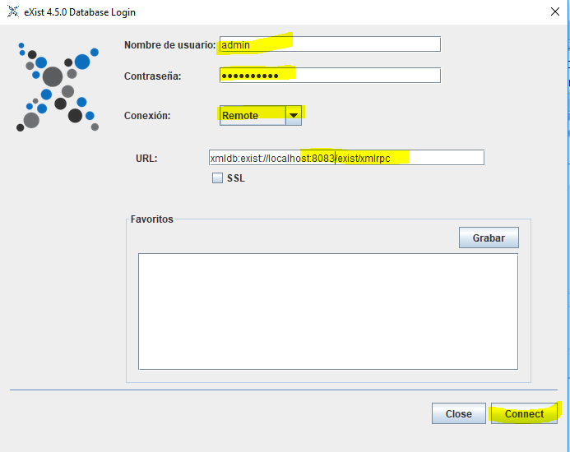
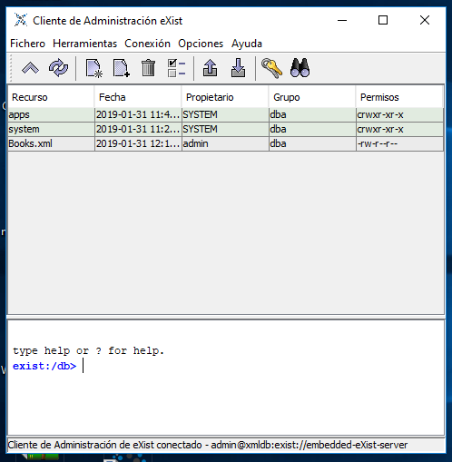
PRACTICE 3.1. INSTALLING EXISTS DB

Slide 7
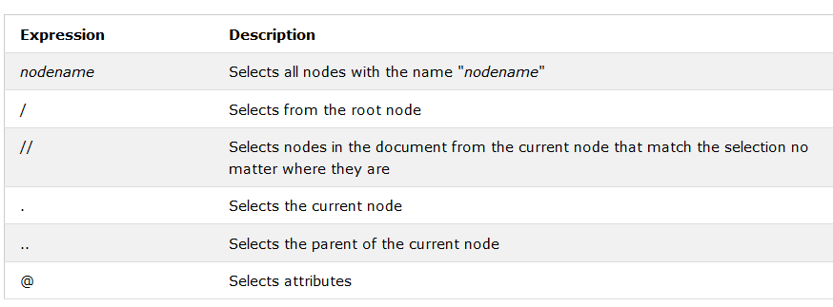
XPATH
https://www.w3schools.com/xml/xpath_intro.asp

Slide 8
XPATH EXAMPLES

Slide 9
XQUERY
https://www.w3schools.com/xml/xquery_intro.asp
XQuery is the language for querying XML data
XQuery for XML is like SQL for databases
XQuery is built on XPath expressions
XQuery is supported by all major databases
XQuery is a W3C Recommendation
XQuery uses path expressions to navigate through elements in an XML document.
The following path expression is used to select all the title elements in the "books.xml" file:
doc("books.xml")/bookstore/book/title
(/bookstore selects the bookstore element, /book selects all the book elements under the bookstore element, and /title selects all the title elements under each book element)

Slide 10
XQuery FLWOR Expressions
FLWOR (pronounced "flower") is an acronym for "For, Let, Where, Order by, Return".
For - selects a sequence of nodes
Let - binds a sequence to a variable
Where - filters the nodes
Order by - sorts the nodes
Return - what to return (gets evaluated once for every node)
for $x in doc("books.xml")/bookstore/book where $x/price>30 return $x/title

Slide 11
1)for $x in doc("books.xml")/bookstore/book where $x/price>30 order by $x/title return $x/title

Slide 12
Present the Result In an HTML List
<ul> { for $x in doc("books.xml")/bookstore/book/title order by $x return <li>{$x}</li> } </ul>

Slide 13
XML,XQUERY AND JAVA
We can access an xml database such as eXistdb and do queries.
We will use the objects Collection, XPathQueryService and ResourceSet .
XPathQueryService servicio= (XPathQueryService)col.getService("XPathQueryService", "1.0");
ResourceSet result=
servicio.query("for $b in /Books/Book/Title/text() return $b");

Slide 14
Practice 5.2. ACCESS TO EXISTDB WITH JAVA

